Slide 1

Nguyen Le Minh Nhut 19110100
Pham Viet Anh 19110151
Bui Duc Nhan 19110004
Tran Dang Khoa 19110145
E-COMMERCE PLATFORM
- BY GROUP 3 -

Slide 2
Definition
ECOMMERCE PLATFORM
E-COMMERCE PLATFORM
In the short way, an Ecommerce platform is a software application allows businesses to directly manage their website marketing, sales and operations.
- BY GROUP 3 -
Nguyen Le Minh Nhut 19110100
Pham Viet Anh 19110151
Bui Duc Nhan 19110004
Tran Dang Khoa 19110145

Slide 3
Definition
ECOMMERCE PLATFORM
E-COMMERCE PLATFORM
In the short way, an Ecommerce platform is a software application allows businesses to directly manage their website marketing, sales and operations.
There are 2 ways to use an Ecommerce platform:
On-premise platform allow the businesses have more control over their site.
Software-as-a-Service (SaaS) and Platform-as-a-Service (PaaS) are simpler options.
- BY GROUP 3 -
Nguyen Le Minh Nhut 19110100
Pham Viet Anh 19110151
Bui Duc Nhan 19110004
Tran Dang Khoa 19110145

Slide 4
Definition
ECOMMERCE PLATFORM
E-COMMERCE PLATFORM
There are 2 ways to use an Ecommerce platform:
- On-premise platform allow the businesses have more control over their site.
- Software-as-a-Service (SaaS) and Platform-as-a-Service (PaaS) are simpler options.
Some examples for E-commerce platform:
- shoptify
- bigcartel
- magento
- woo commerce
- wix.com
- square space
- BY GROUP 3 -
Nguyen Le Minh Nhut 19110100
Pham Viet Anh 19110151
Bui Duc Nhan 19110004
Tran Dang Khoa 19110145
In the short way, an Ecommerce platform is a software application allows businesses to directly manage their website marketing, sales and operations.

Slide 5
Definition
ECOMMERCE PLATFORM
Some examples for E-commerce platform:
- SHOPTIFY
- BIGCARTEL
- MAGENTO
- WOO COMMERCE
- WIX.COM
- SQUARE SPACE
There are 2 ways to use an Ecommerce platform:
- On-premise platform allow the businesses have more control over their site.
- Software-as-a-Service (SaaS) and Platform-as-a-Service (PaaS) are simpler options.

Slide 6

Definition
Key factors for building a good E-commerce platform
ECOMMERCE PLATFORM
Some examples for E-commerce platform:
- SHOPTIFY
- BIGCARTEL
- MAGENTO
- WOO COMMERCE
- WIX.COM
- SQUARE SPACE
Usability and Persuasiveness
Accessibility
Customer-Centric

Slide 7
Usability & Persuasivenesss
Usability
Key factors for building a good E-commerce platform
Usability and Persuasiveness
Accessibility
Customer-Centric
The capacity of a system to provide a condition for its users to perform the tasks safely, effectively, and efficiently while enjoying the experience.
"The extent to which a product can be used by specified users to achieve specified goals with effectiveness, efficiency, and satisfaction in a specified context of use."
The word "usability" also refers to methods for improving ease-of-use during the design process.

Slide 8

Usability
Usability & Persuasivenesss
FIVE QUALITY COMPONENTS
The capacity of a system to provide a condition for its users to perform the tasks safely, effectively, and efficiently while enjoying the experience.
"The extent to which a product can be used by specified users to achieve specified goals with effectiveness, efficiency, and satisfaction in a specified context of use."
The word "usability" also refers to methods for improving ease-of-use during the design process.
Learnability
Efficiency
Memorability
Errors
Satisfaction

Slide 9
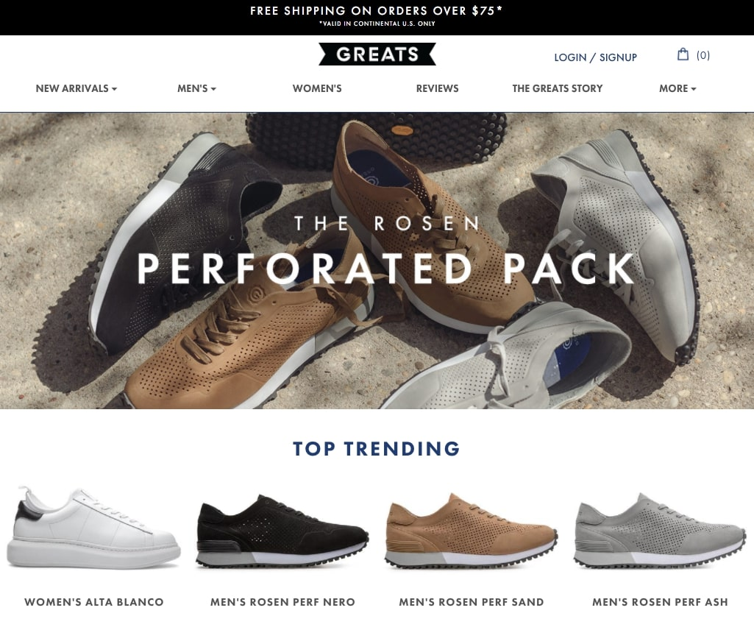

Usability
Usability & Persuasivenesss
FIVE QUALITY COMPONENTS
The capacity of a system to provide a condition for its users to perform the tasks safely, effectively, and efficiently while enjoying the experience.
"The extent to which a product can be used by specified users to achieve specified goals with effectiveness, efficiency, and satisfaction in a specified context of use."
The word "usability" also refers to methods for improving ease-of-use during the design process.
Learnability
Efficiency
Memorability
Errors
Satisfaction

Slide 10
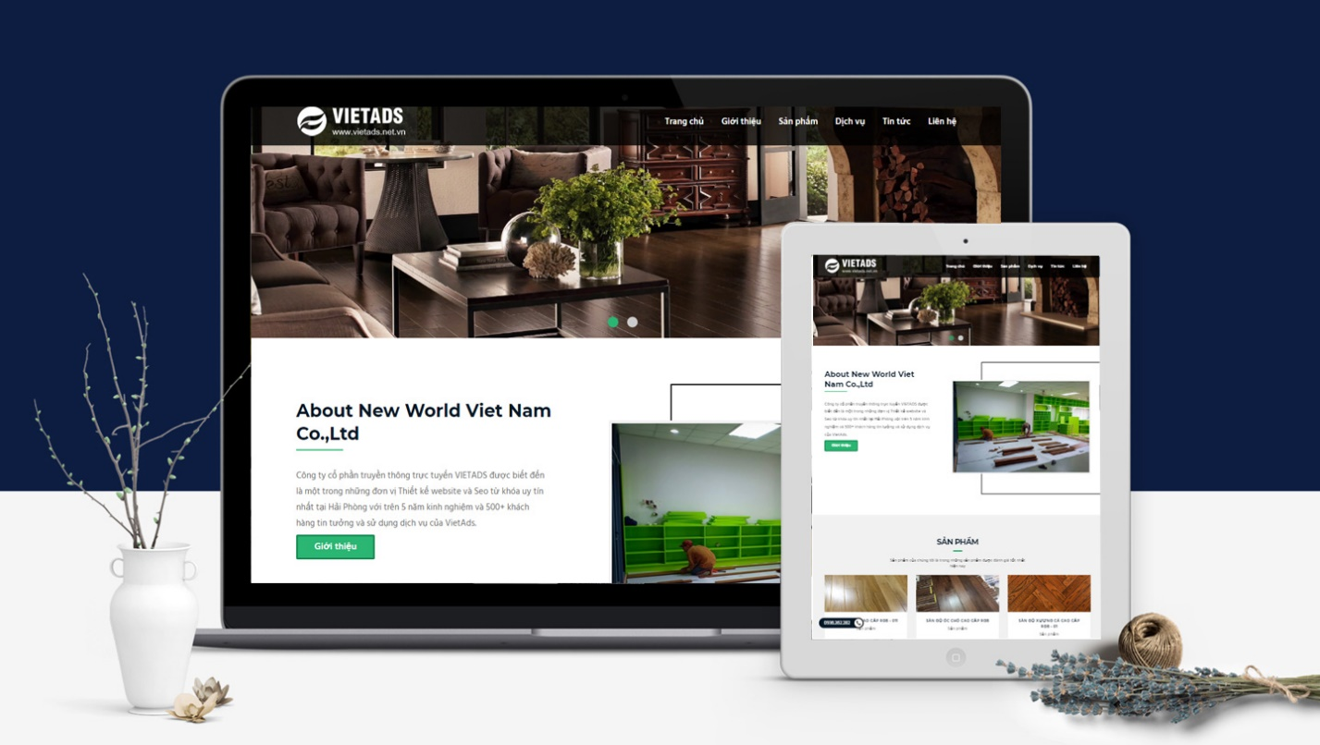
Usability
Usability & Persuasivenesss
Learnability
FIVE QUALITY COMPONENTS
The capacity of a system to provide a condition for its users to perform the tasks safely, effectively, and efficiently while enjoying the experience.
"The extent to which a product can be used by specified users to achieve specified goals with effectiveness, efficiency, and satisfaction in a specified context of use."
The word "usability" also refers to methods for improving ease-of-use during the design process.
How easy is it for users to accomplish basic tasks the first time they encounter the design?
Efficiency
Memorability
Errors
Satisfaction

Slide 11


Usability
Usability & Persuasivenesss
Efficiency
Memorability
FIVE QUALITY COMPONENTS
The capacity of a system to provide a condition for its users to perform the tasks safely, effectively, and efficiently while enjoying the experience.
"The extent to which a product can be used by specified users to achieve specified goals with effectiveness, efficiency, and satisfaction in a specified context of use."
The word "usability" also refers to methods for improving ease-of-use during the design process.
Once users have learned the design, how quickly can they perform tasks?
Efficiency
Memorability
Errors
Satisfaction

Slide 12
Efficiency
Once users have learned the design, how quickly can they perform tasks?
Memorability
Errors
When users return to the design after a period of not using it, how easily can they re-establish proficiency?
How many errors do users make, how severe are these errors, and how easily can they recover from the errors?

Slide 13
Errors
Memorability
How many errors do users make, how severe are these errors, and how easily can they recover from the errors?
When users return to the design after a period of not using it, how easily can they re-establish proficiency?

Slide 14
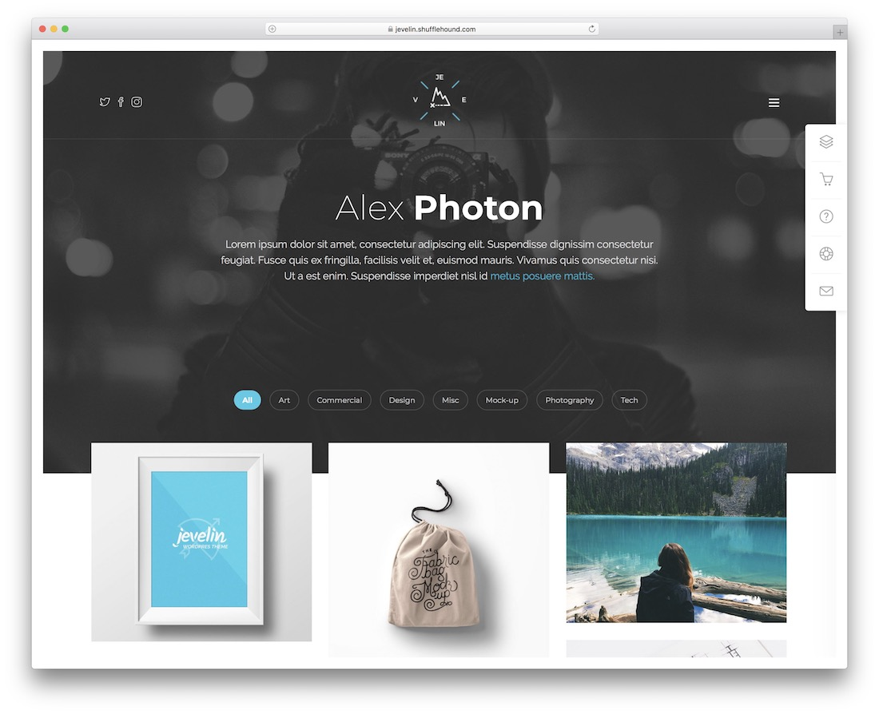
Errors
Satisfaction
How pleasant is it to use the design?
How many errors do users make, how severe are these errors, and how easily can they recover from the errors?

Slide 15
Satisfaction
Why Usability is so important ?
How pleasant is it to use the design?
The principle is simple: users come to your website, immediately find what they need, and you get the customers. You literally, step by step, lead them to the desired goal. If everything goes as planned, macro and micro conversion rates will grow.
There's no such thing as a training class or a manual for a Web site. People have to be able to grasp the functioning of the site immediately after scanning the home page—for a few seconds at most." Otherwise, most casual users simply leave the site and browse or shop elsewhere.

Slide 16

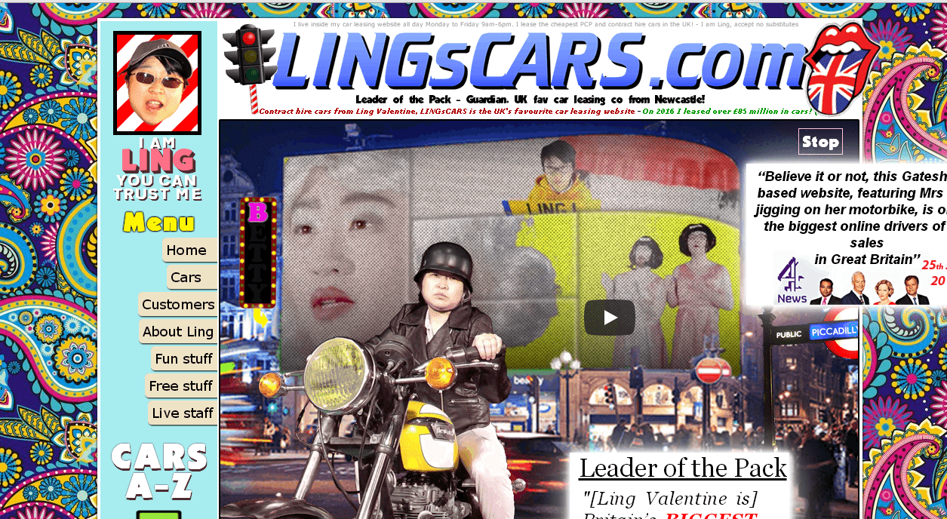


Advantages:
- Competitive edge
Website responsiveness
Download speed
Interesting content
Promotion in search
Targeted traffic
Improvements
Great recommendations
....
Persuasiveness

Slide 17
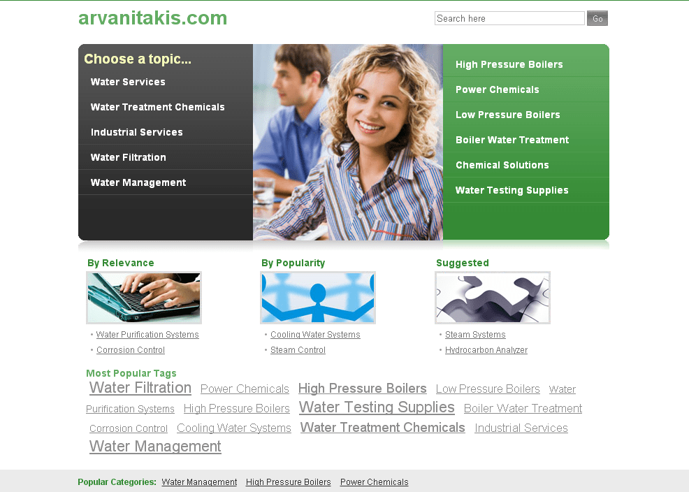
Advantages:
- Competitive edge
Website responsiveness
Download speed
Interesting content
Promotion in search
Targeted traffic
Improvements
Great recommendations
....
After landing on such a website, it’s hard to understand whether its design was chosen intentionally or this is nothing but a fiasco.
Persuasiveness

Slide 18
Advantages:
It has no information about the services or company and nothing about the advantages and characteristics of products.
- Competitive edge
Website responsiveness
Download speed
Interesting content
Promotion in search
Targeted traffic
Improvements
Great recommendations
....
Persuasiveness

Slide 19
Advantages:
- Competitive edge
Website responsiveness
Download speed
Interesting content
Promotion in search
Targeted traffic
Improvements
Great recommendations
....
Persuasiveness

Slide 20
Advantages:
The capability of a person or argument to convince or persuade someone to accept a desired way of thinking.
In e-commerce, the persuasive design of e-commerce websites has been shown to support people with online purchases. Therefore, it is important to understand how persuasive applications are used and assimilated into e-commerce website designs.
Persuasiveness
- Competitive edge
Website responsiveness
Download speed
Interesting content
Promotion in search
Targeted traffic
Improvements
Great recommendations
....

Slide 21
Persuasiveness
The capability of a person or argument to convince or persuade someone to accept a desired way of thinking.
In e-commerce, the persuasive design of e-commerce websites has been shown to support people with online purchases. Therefore, it is important to understand how persuasive applications are used and assimilated into e-commerce website designs.
- Competitive edge
Website responsiveness
Download speed
Interesting content
Promotion in search
Targeted traffic
Improvements
Great recommendations
....

Slide 22

Persuasiveness
6
The capability of a person or argument to convince or persuade someone to accept a desired way of thinking.
In e-commerce, the persuasive design of e-commerce websites has been shown to support people with online purchases. Therefore, it is important to understand how persuasive applications are used and assimilated into e-commerce website designs.
PRINCIPLES
- Competitive edge
Website responsiveness
Download speed
Interesting content
Promotion in search
Targeted traffic
Improvements
Great recommendations
....

Slide 23
Reciprocity
6
Commitment and Consistency
Social Proof
Authority
PRINCIPLES
Liking
Scarcity

Slide 24
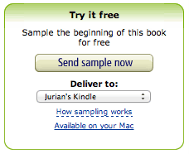
Most people feel the need to return a favor.
The way you can use this is pretty straightforward: give something away that has real value to your visitors. Amazon does a great job at this by providing free chapters of a lot of books for the Kindle
Reciprocity
Commitment and Consistency
Social Proof
Authority
Liking
Scarcity
6
PRINCIPLES

Slide 25
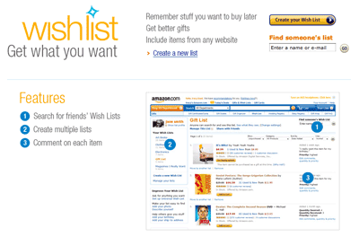
When people agree to an idea or goal, they will probably honor that commitment later. They will even do that if the original incentive or motivation is removed.
This is because people come to see the commitment as congruent with their self-image. This is how cognitive dissonance works, and why someone who did you a small favor tends to like you more than someone who didn't.
Most people feel the need to return a favor.
The way you can use this is pretty straightforward: give something away that has real value to your visitors. Amazon does a great job at this by providing free chapters of a lot of books for the Kindle
Reciprocity
Commitment and Consistency
Social Proof
Authority
Liking
Scarcity

Slide 26
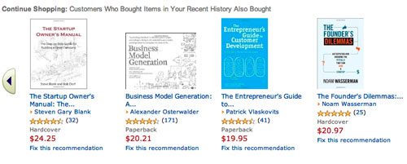
An obvious way to show that your site is actually being used and appreciated is showing off Facebook likes, Twitter followers and Google +1s.
Of course, you will need a decent number of followers for that. Another clever move is to ask users to leave a review of your shop after they gave positive feedback. This way you can quickly collect positive testimonials which you can use to persuade others.
When people agree to an idea or goal, they will probably honor that commitment later. They will even do that if the original incentive or motivation is removed.
This is because people come to see the commitment as congruent with their self-image. This is how cognitive dissonance works, and why someone who did you a small favor tends to like you more than someone who didn't.
Reciprocity
Commitment and Consistency
Social Proof
Authority
Liking
Scarcity

Slide 27

An obvious way to show that your site is actually being used and appreciated is showing off Facebook likes, Twitter followers and Google +1s.
Of course, you will need a decent number of followers for that. Another clever move is to ask users to leave a review of your shop after they gave positive feedback. This way you can quickly collect positive testimonials which you can use to persuade others.
Authority doesn’t only come from famous people or professors, however. Many e-commerce sites use badges of security certificates, given to them by third parties. These third parties are seen as security experts and invoke a feeling of transparancy.
Reciprocity
Commitment and Consistency
Social Proof
Authority
Liking
Scarcity

Slide 28
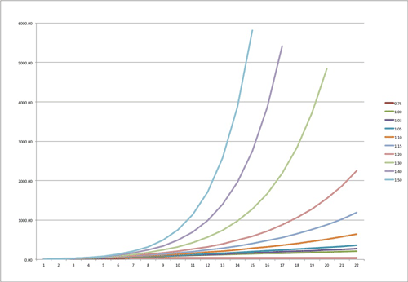
We take a recommendation from a friend to heart because doing so validates our belonging to our group of friends.
This is why it is so valuable to ‘go viral’. Recommendations by friends are seen as very valuable, and people return the favor by passing the advice along. Before you know it, your content spreads exponentially.
Authority doesn’t only come from famous people or professors, however. Many e-commerce sites use badges of security certificates, given to them by third parties. These third parties are seen as security experts and invoke a feeling of transparancy.
Reciprocity
Commitment and Consistency
Social Proof
Authority
Liking
Scarcity

Slide 29
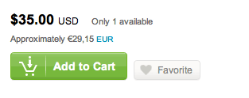
We take a recommendation from a friend to heart because doing so validates our belonging to our group of friends.
This is why it is so valuable to ‘go viral’. Recommendations by friends are seen as very valuable, and people return the favor by passing the advice along. Before you know it, your content spreads exponentially.
If something is hard to get, people will want it more. Scarcity makes a product seem desirable and cool.
Apple knows how to make use of this principle very well. People stand in ridiculously long queues at every new product launch, which creates a lot of hype and free press.
Reciprocity
Commitment and Consistency
Social Proof
Authority
Liking
Scarcity

Slide 30
If something is hard to get, people will want it more. Scarcity makes a product seem desirable and cool.
Apple knows how to make use of this principle very well. People stand in ridiculously long queues at every new product launch, which creates a lot of hype and free press.
Reciprocity
Commitment and Consistency
Social Proof
Authority
Liking
Scarcity

Slide 31
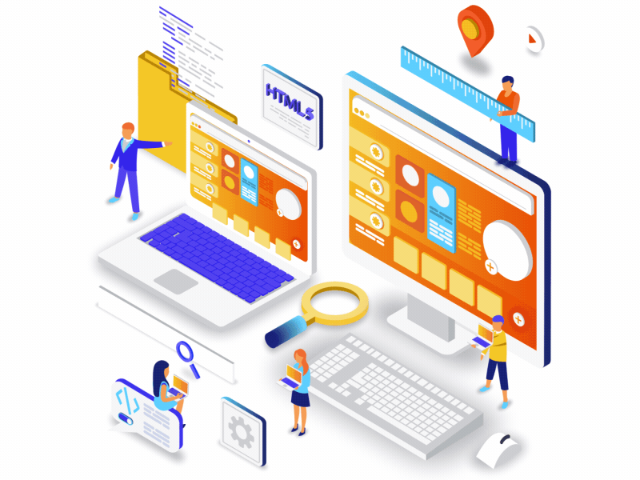
03
Web accessibility and Responsive Website

Slide 32
Definition
Web Accessibility
Web accessibility means that websites, tools, and technologies are designed and developed so that people can use them easier.
Websites must provide equal access and equal opportunity to people with disabilities.

Slide 33
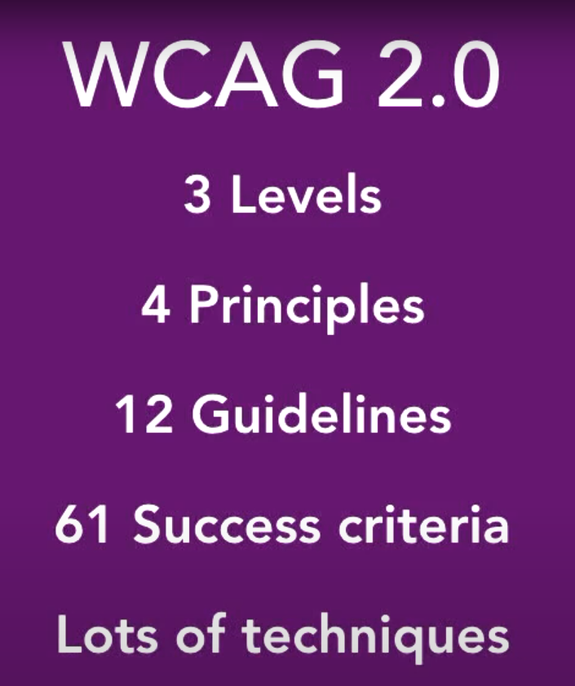
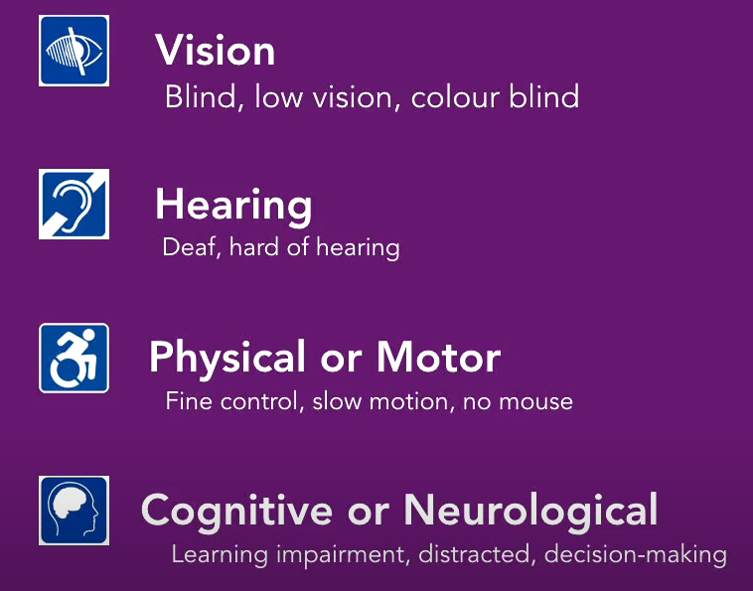
Web Content Accessibility Guidelines (WCAG) 2.0 standard:
Developed by the World Wide Web Consortium(W3C).
It covers a wide range of recommendations for making Web content more accessible.
Web accessibility encompasses all disabilities that affect access to the Web:

Slide 34
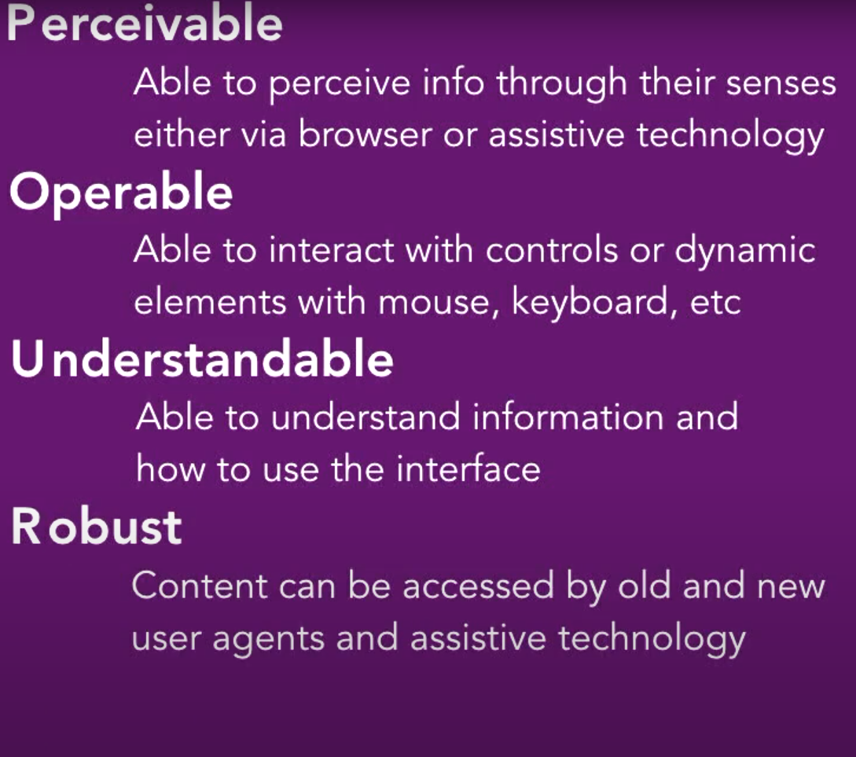
Web Content Accessibility Guidelines (WCAG) 2.0 standard:
4 Principle of Accessibility
The Web Content Accessibility Guidelines(WCAG) are organized into three levels of conformance:
- Level A – the most basic web accessibility features.
- Level AA – deals with the leading and most common barriers for disabled users
- Level AAA – meant primarily for sites that serve the disabled community.

Slide 35
WCAG 2.0
1
2
3
4
Perceivable
Operable - User interface components and navigation must be operable
Understandable
Robust

Slide 36
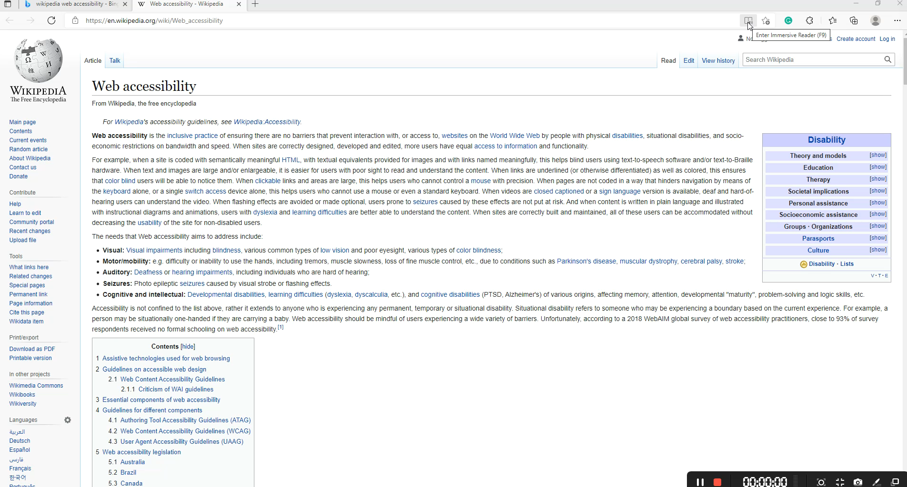
Perceivable

Slide 37

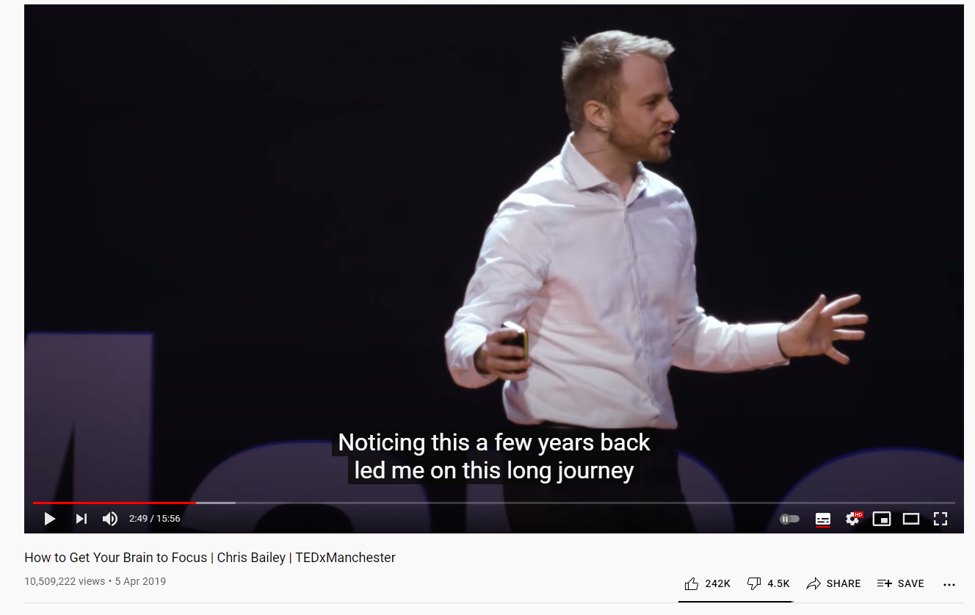
Non-text Content
Non-text content that is presented to the user has a text alternative that serves the equivalent purpose.
Example: A non-text content must have a alternative that display the equivalent content so that deaf people can acknowledge the content.
<img src="img_girl.jpg" alt="" width="500" height="600"> => This is wrong
<img src="img_girl.jpg" alt="Business school professor pointing to a
student's computer screen" width="500" height="600"> => This is more correct

Slide 38

Audio-only and Video-only
The intent of this Success Criterion is to make information conveyed by prerecorded audio-only and video-only content available to all users.
Example:
- A video-only file with an audio track
- A silent movie includes an audio track which includes a description of the action in the video.

Slide 39
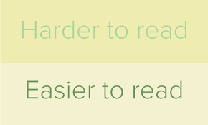
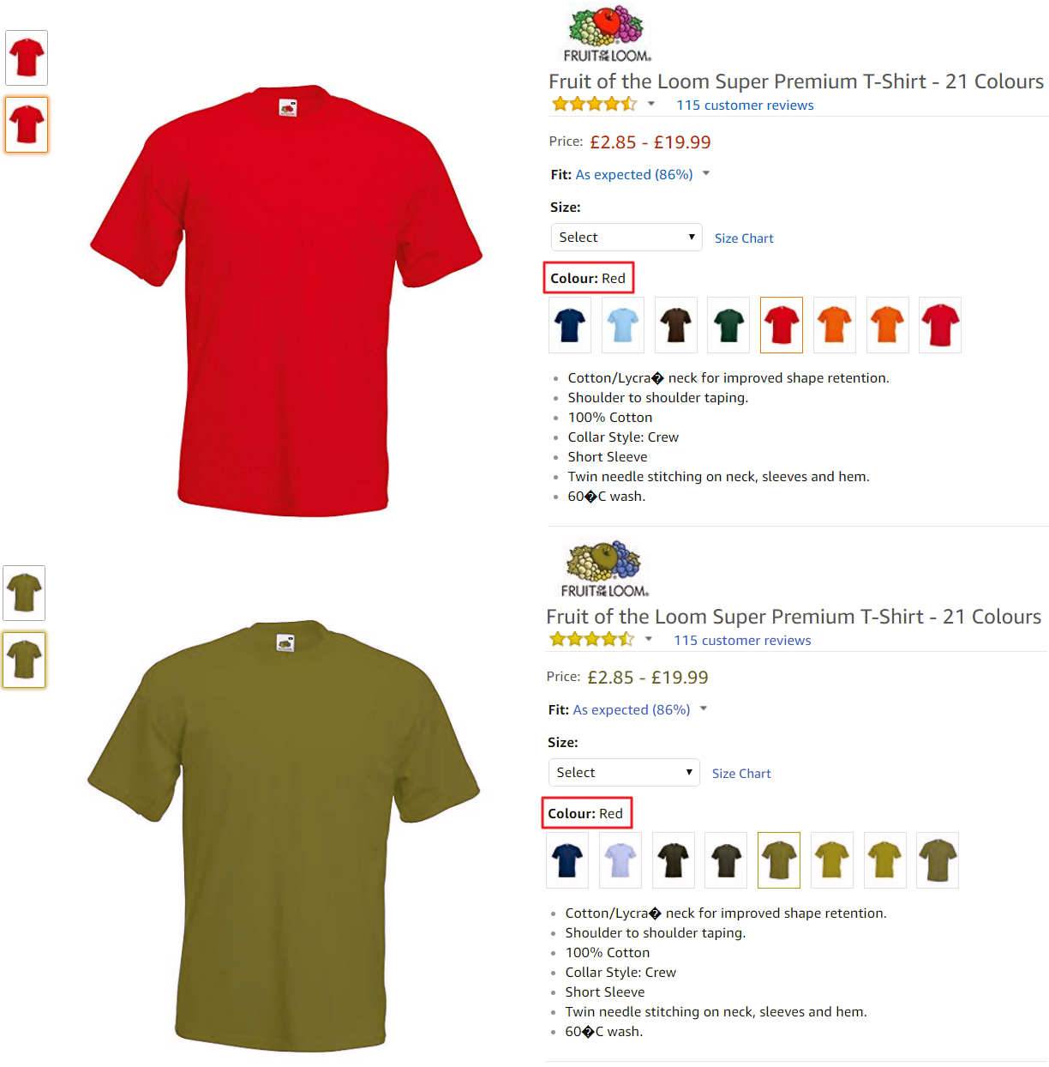
Use of Color
People with partial sight often experience limited color vision:
The intent of this Success Criterion is to ensure that all users can access information providing the information for users who cannot see color can still perceive the information.
Color is an important asset in design of Web content. However, some users have difficulty perceiving color. People with partial sight often experience limited color vision, and many older users do not see color well.
Example of descriptive title about the color of an object

Slide 40
Operable - User interface components and navigation must be operable
This means that users must be able to operate the interface (the interface cannot require interaction that a user cannot perform)
People who are blind
People with low vision
Some people with hand tremors (shaky hand) find using a mouse very difficult and therefore usually use a keyboard

Slide 41
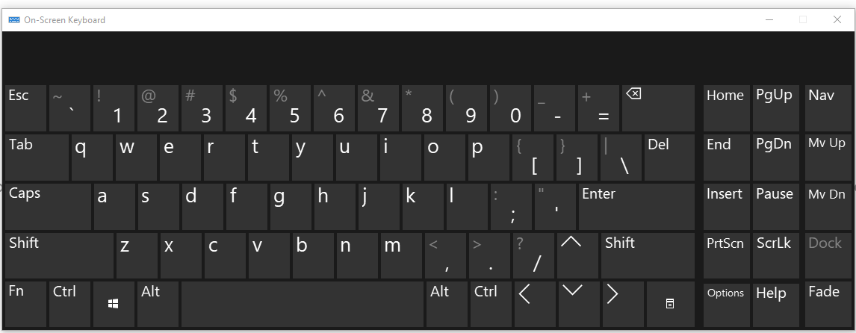
Operable - User interface components and navigation must be operable
Keyboard
The intent of this Success Criterion is to ensure that, wherever possible, content can be operated through a keyboard or a virtual keyboard interface (so an alternate keyboard can be used).
Keyboard emulators include speech input software, on-screen keyboards, scanning software and a variety of assistive technologies and alternate keyboards.
On window we have tool called on screen keyboard:

Slide 42
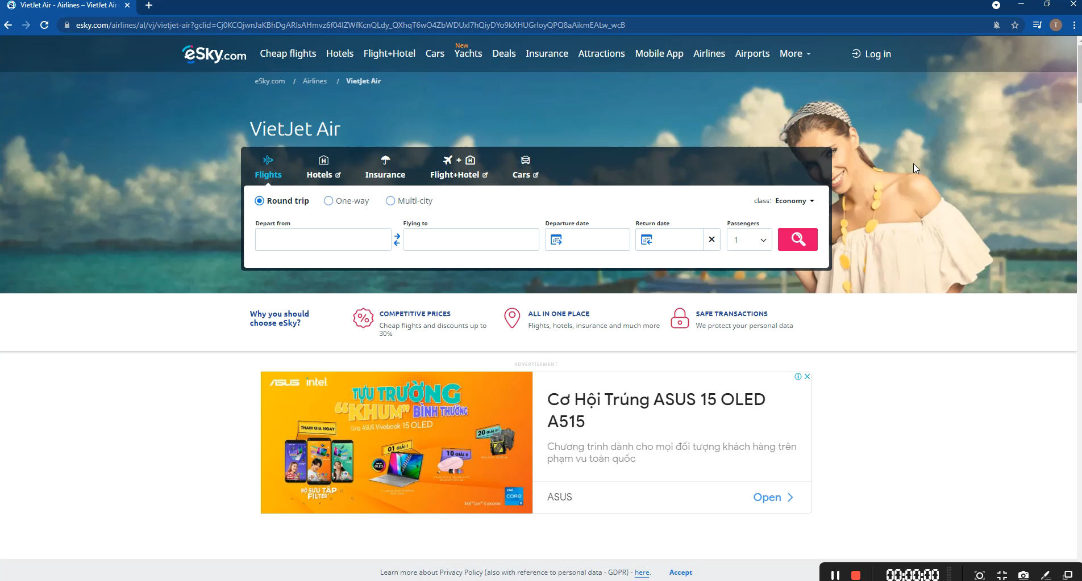
Operable - User interface components and navigation must be operable
This will take so much time if you want to scroll to the website’s main content pressing Tab all day

Slide 43
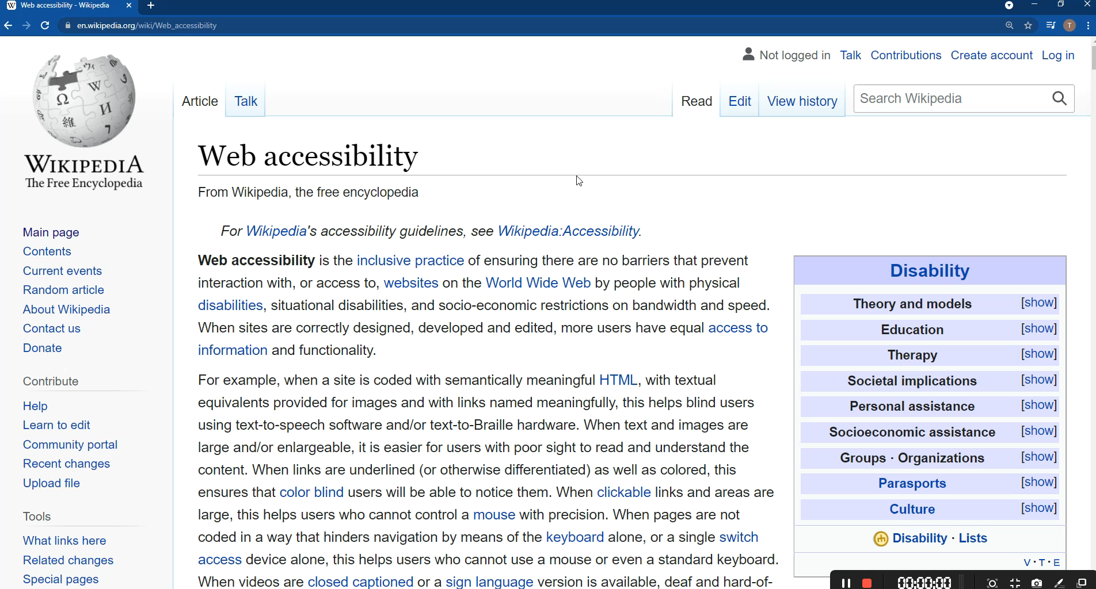
Operable - User interface components and navigation must be operable
If you implement skip link, people using keyboard only will have an easier time looking for the main content

Slide 44
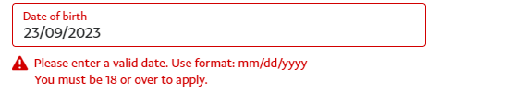
Understandable
Error Identification
Make text content readable and understandable.
People with certain cognitive ( tầm nhận thức hạn chế), language and learning disabilities can understand the content.
Example: Young children, old people.
Forms that require a lot of information to be filled
The user enters a non existent zip or postal code;
the user fails to enter the proper abbreviation in to state, province, region, etc. field;
The user enters alphabetic characters or parentheses into their phone number field that only accepts numbers;
Spelling check.

Slide 45
Robust
To ensure that Assistive Technologies (AT) can gather information about, activate(or set) and keep up to date on the status of user interface controls in the content.
Providing role, state, and value information on all user interface components enables compatibility with assistive technology, such as screen readers, and speech recognition software, used by people with disabilities.

Slide 46
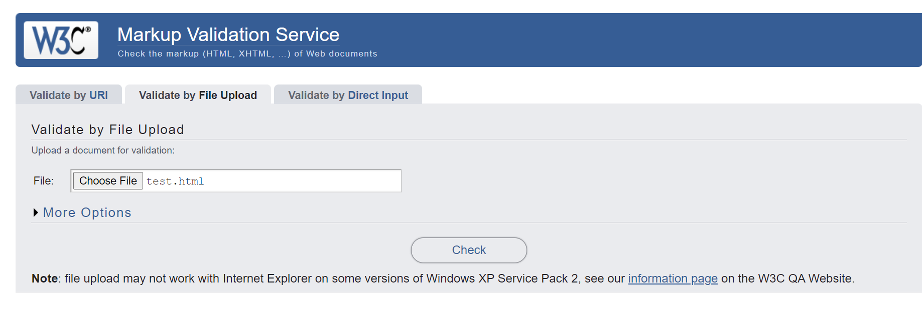
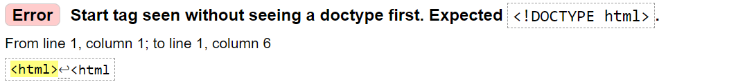
Parsing
In content implemented using markup languages, elements have complete start and end tags, elements are nested according to their specifications, elements do not contain duplicate attributes, and any IDs are unique.
To check that your website is readable by the assistive technology, you can use the website:
https://validator.w3.org/

Slide 47
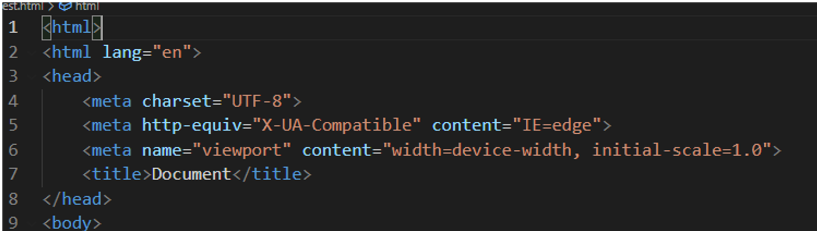
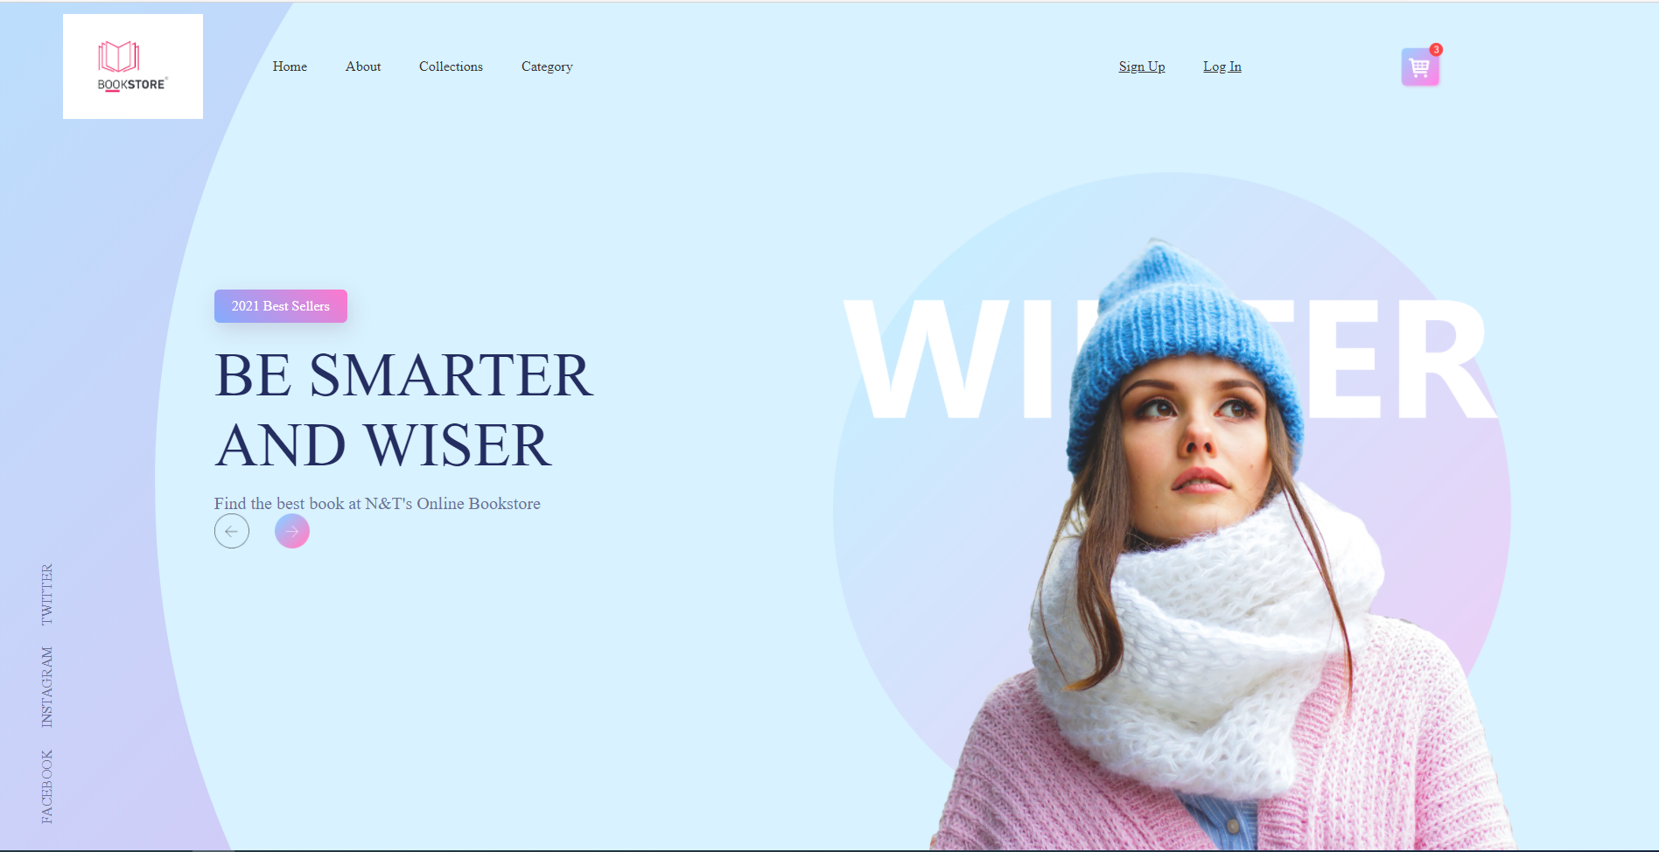
Parsing
The Error tell me to add a “!DOCTYPE HTML” tag to insure the ‘Robust’ Principle
I still able to run my website without the tag

Slide 48
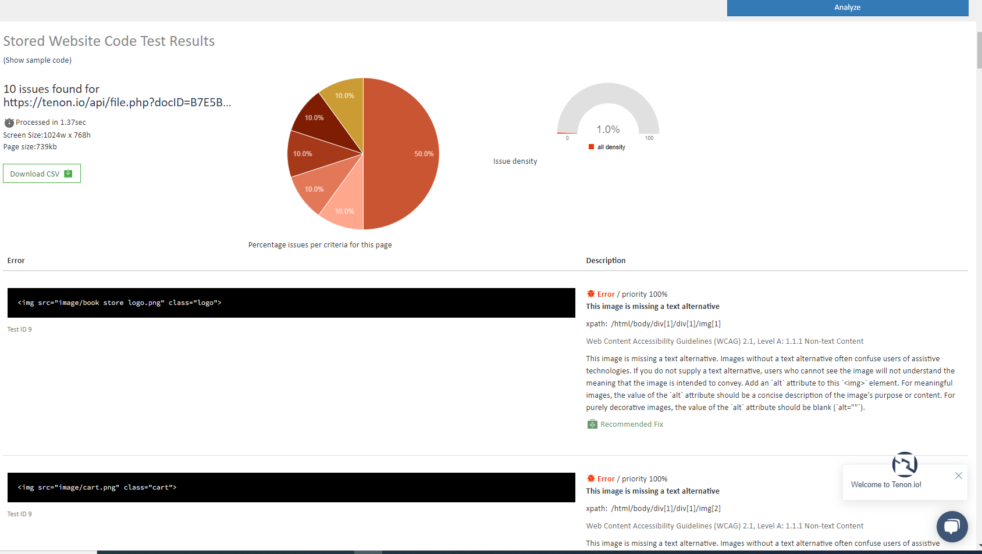
Name, Role, Value
If you want to check you accessibility of your website go to: tenon.io
In this, the text is contained in the button element, in this case "save", as the name. There is no value.
<button>Save</button>
In this example, we uses the 'value' attribute, in this case "Save", "Submit", or "Reset" as the name. That mean the assistive technology can tell the user the purpose of these button.
<input type="button" value="Save" />
<input type="submit" value="Submit" />
<input type="reset" value="Reset" />

Slide 49
Web Responsive
Responsive Web Design is about using HTML and CSS to automatically resize, hide, shrink, or enlarge, a website, to make it look good on all devices (desktops, tablets, and phones)

Slide 50
Which to prioritize?
- Pc first then mobile?
- Mobile first then PC?
=> It depends on your decision, both are all fine.!
Common widths of devices:
320: iPhone 5/SE
768: iPad
1024: iPad Pro
1280: Laptop screen

Slide 51
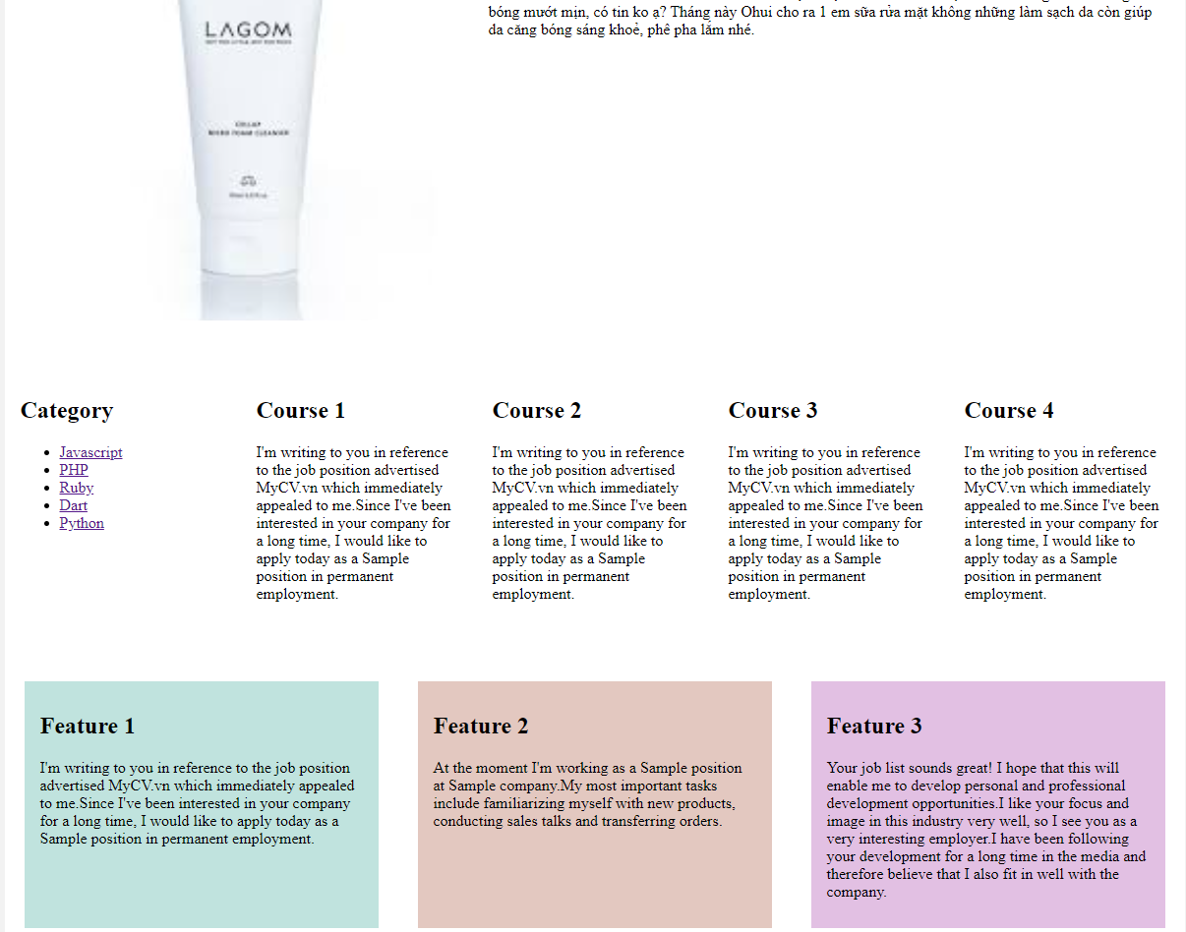
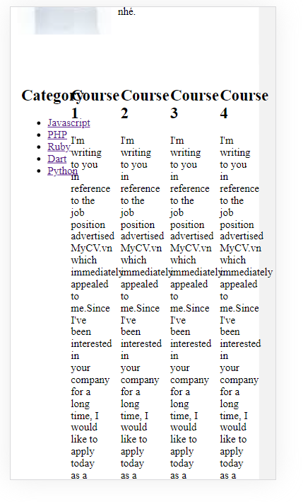
Mercury
Desktop screen
IPhone5 screen

Slide 52
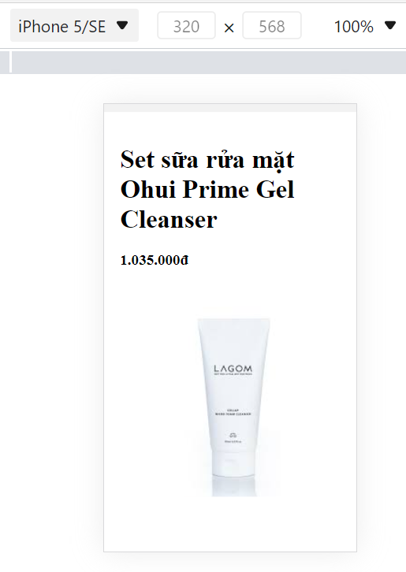
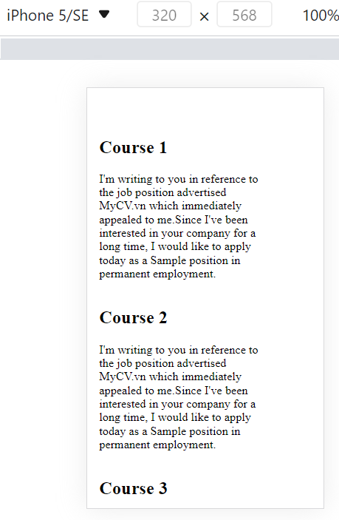

Slide 53
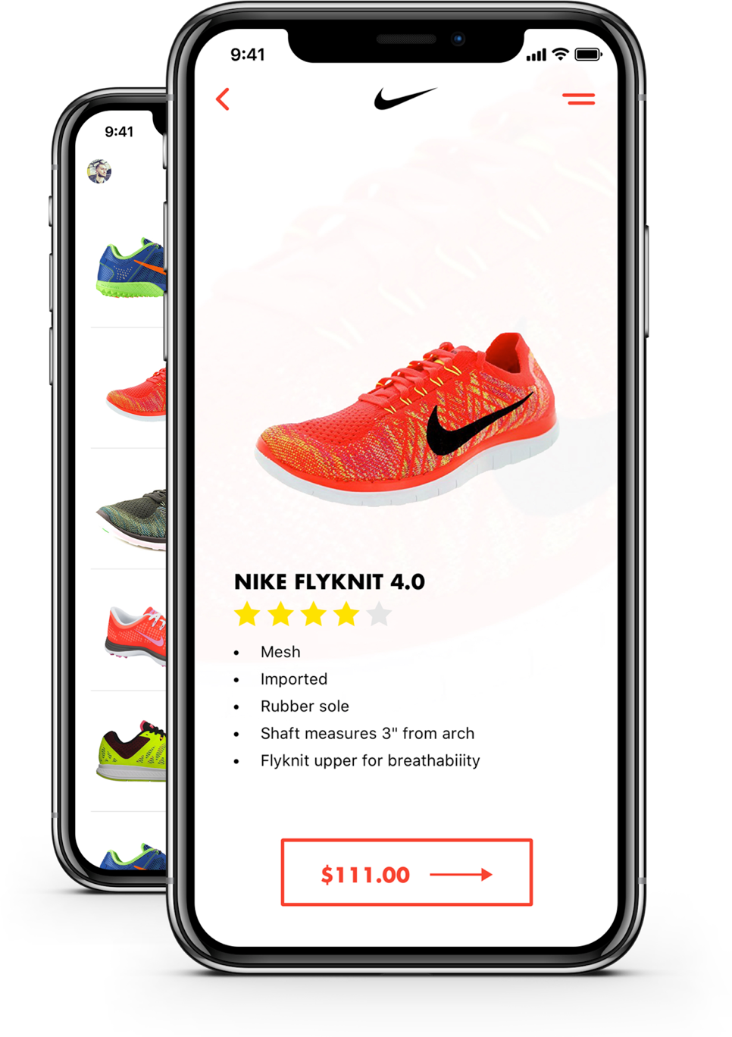
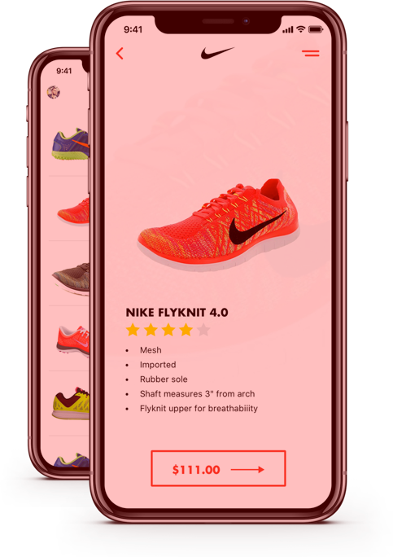
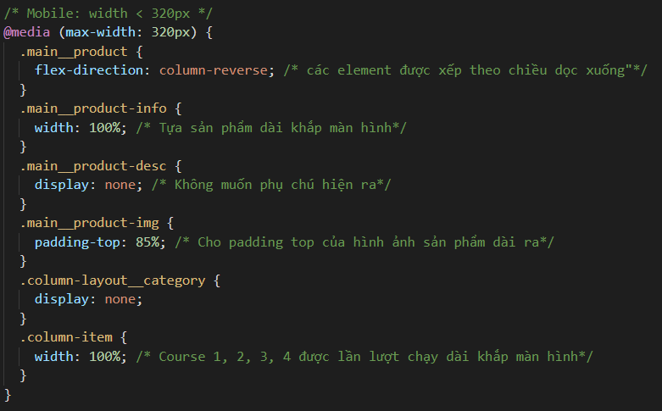
Breakpoint in Css
2 version of an image ( colored Red to identify)
twoPhones.png
1 MB, used in PC
twoPhones-small.png
1kb, used in Mobile

Slide 54
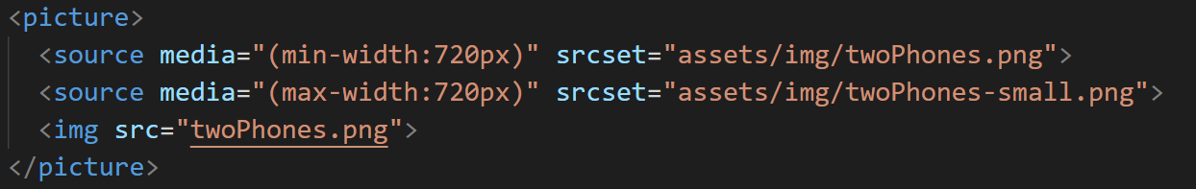
Responsive Image
Min-width : the width of the viewport (browser)
If width > 720 px: Display the heavy Image
If Width < 720 px: Display the lighter version of the Image

Slide 55
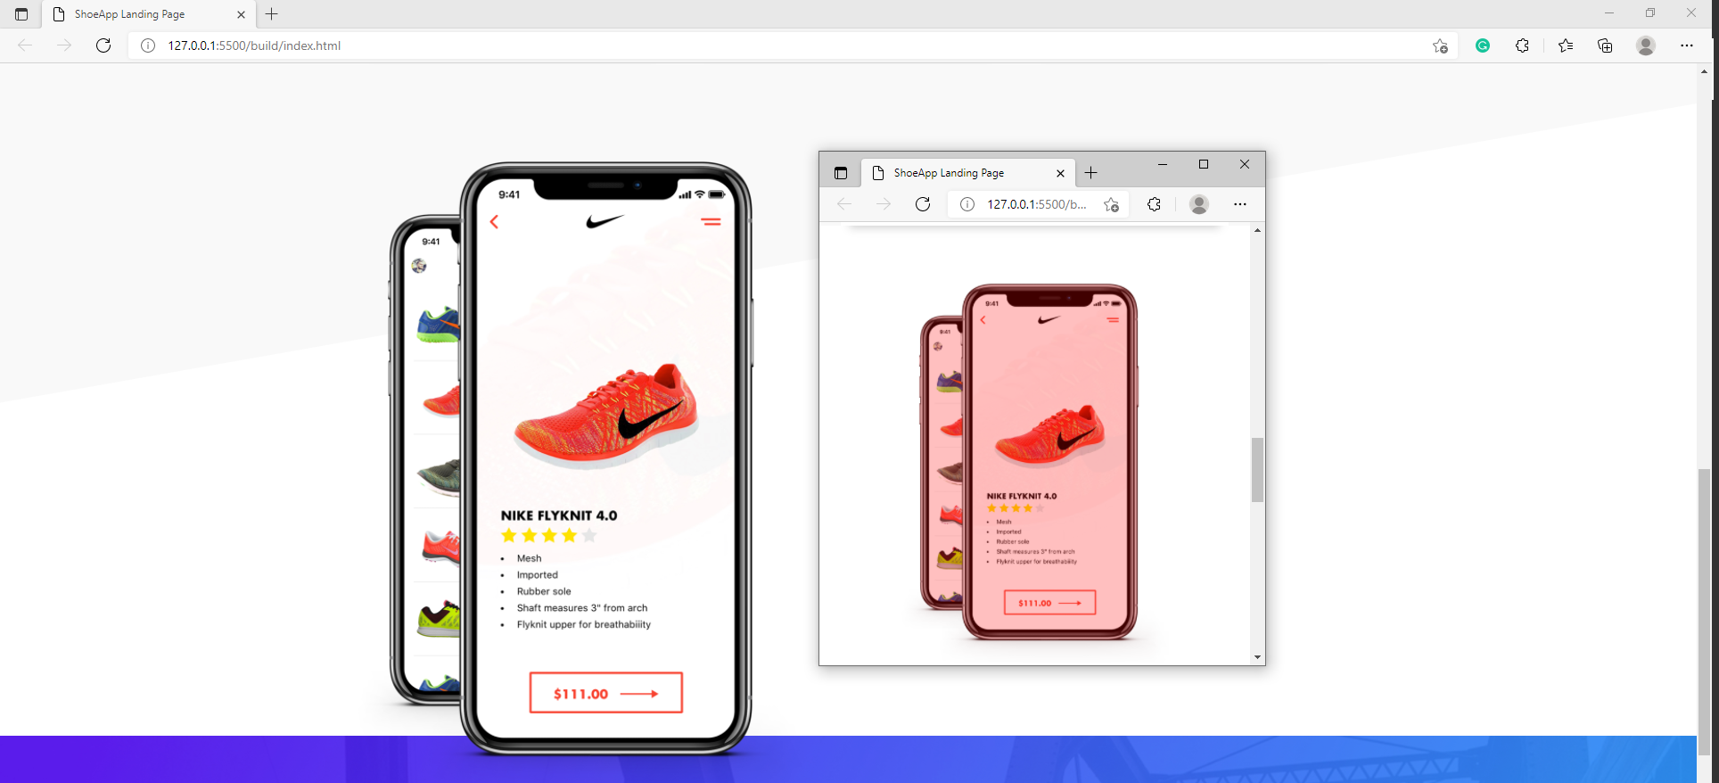
Two version of Image getting displayed

Slide 56
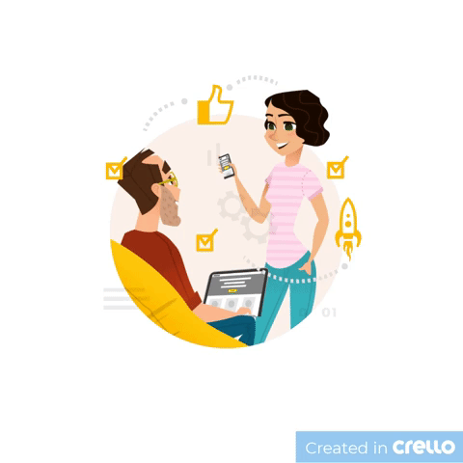
04
Customer-Centric
Keep customers happy by finding out what they want and dealing with their problems quickly

Slide 57

What is Customer-Centric?
Customer-centric is a business approach that focuses on creating a positive customer experience by maximizing service, offering compelling products, and building relationships with customers.

Slide 58
Customer-Centric Ecommmerce
Customer-centric e-commerce, as the name suggests, is a strategy that starts and finishes with one goal in mind: excellent customer experiences. The shift from concentrating solely on profit and skewing more towards customer centricity has helped numerous businesses in becoming better overall.

Slide 59
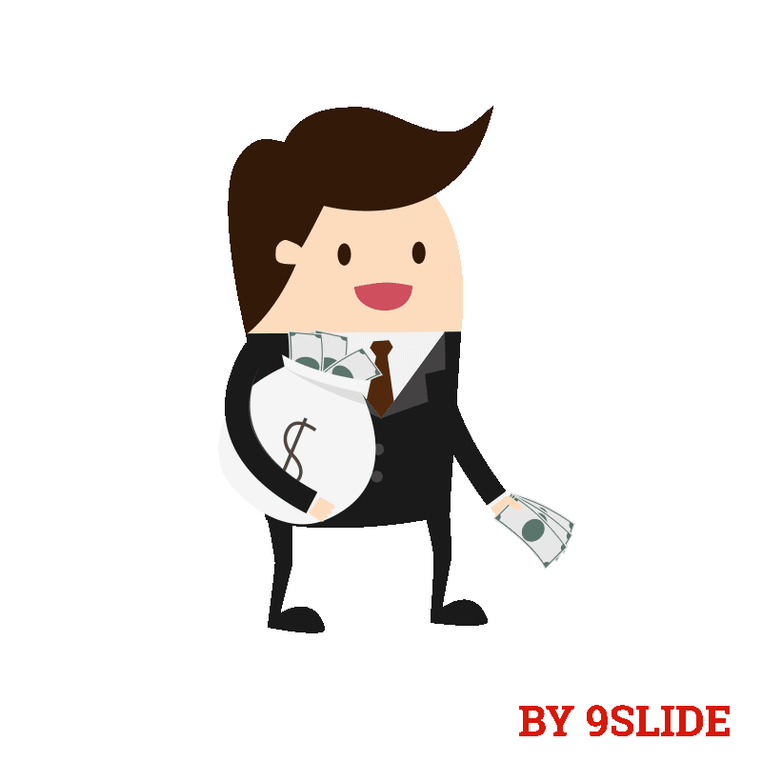
Why it is important?
“The probability of selling to an existing happy customer is around 14 times higher than the probability of selling to a new customer.”
“62% of consumers have stopped doing business with a brand or business due to a bad customer service experience.”
These are some alarming statistics that tell you how significant the shift towards customer-centricity can be for your business. And it’s more than saying you put your customers first. It’s an approach, a mindset that prioritizes delivering exceptional customer experiences before & after-sales.

Slide 60
Why it is important?
Customers at the Heart of Everything
Understanding Customer Demands
Adopting the Customer-Centric Culture

Slide 61
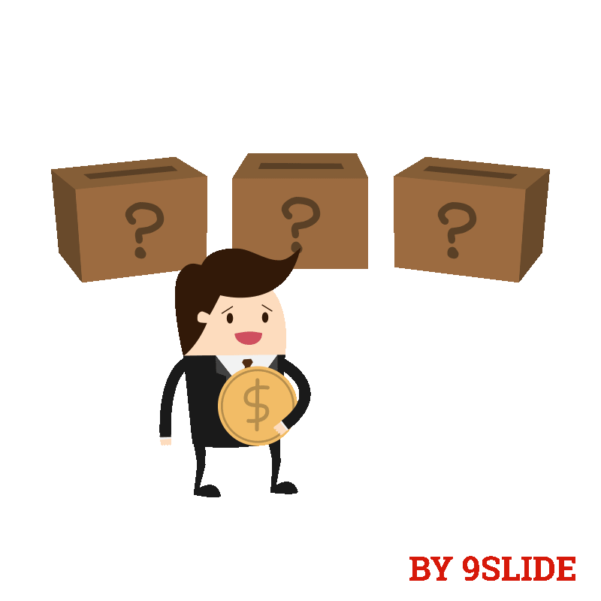
Comparison between Customer-centric and Product-centric
Customer-centric
Product-centric

Slide 62
Maybe you need a table
 | Product-Centric | Customer-Centric
STRATETY | Create the best product | Create best solution for the customer
PEOPLE/CULTURE | New product culture – looking for new products to develop | Customer culture – searching for the needs to fill
PROCESSES | New product development | New solution development, customer experience management
REWARDS/METRICS | Rewards new product development | Rewards people with deep insight into customers
ORGANISATIONAL STRUCTURE | Product divisions with P&L | Customer segment with P&L

Slide 63

How to build Customer-centric Ecommerce

Slide 64
Understand your Ideal Customer Profile (ICP)
Find the Jobs To Be Done for your store/products
Qualitative Research
Measure and monitor Net Promoter Score (NPS)
Map the customer journey
Improve customer acquisition
Enhance your email marketing efforts
Personalize the customer experience on your website
Design customer loyalty programs
Treat your best customers better
Perform Cohort A/B testing

Slide 65
Thank you
For watching
GROUP 3

